Slide 1

MALLA REDDY ENGINEERING COLLEGE
Academic Year 2021-2022
Department of Computer Science and Engineering
MINI PROJECT
Presented By:
Talasila Alekhya
20J41D5801
Guide:
Dr A Rama Swamy Reddy
Professor
Principal - MREC

Slide 2
ANALYSIS OF WOMEN SAFETY ON SOCIAL MEDIA

Slide 3
Abstract
Nowadays women are experiencing lots of violence such as harassment in places in several cities. This starts from stalking which then leads to abusive harassment or also called abuse assault. In this project we mainly focus on the role of social media which can be used to promote the safety of women in India, given the special reference to the participation of many social media websites or applications such as Twitter platform. This project also focuses on developing the responsibilities among the common people on the various parts of Indian cities so that the safety of women around them is ensured. So, this project aims at finding safety percentage of a city in the ideology of women safety by finding polarity of comments.

Slide 4
DATASET
• The dataset we are using is “MeToo_Tweets.csv ”
• There are 15k rows and 3 columns.
• This dataset include many fields about each tweet like Text, Favorite_count and Retweet_ count.
•https://www.kaggle.com/hollyhetherington/metootweets?select=MeToo_twe ets.csv

Slide 5
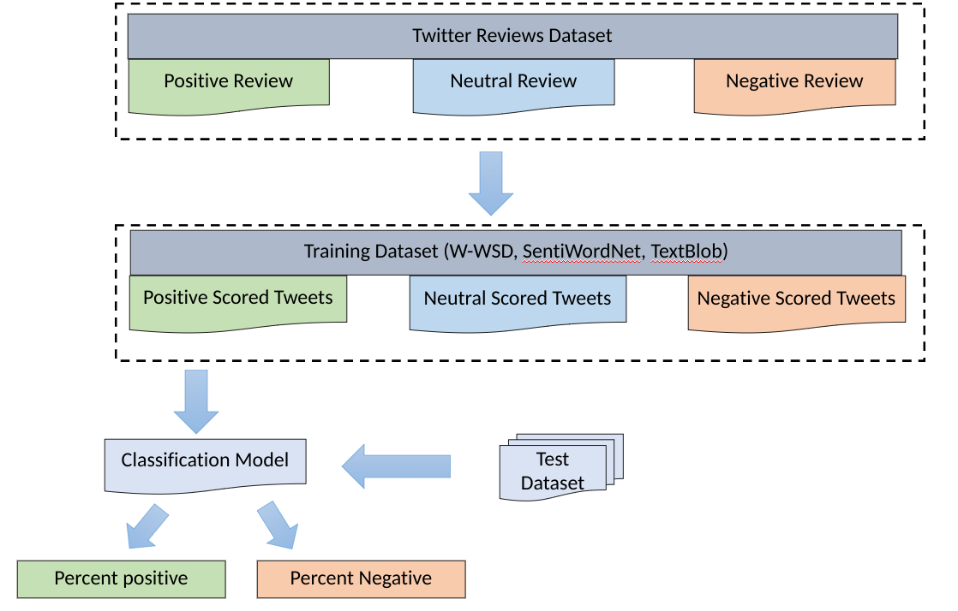
Architecture

Slide 6
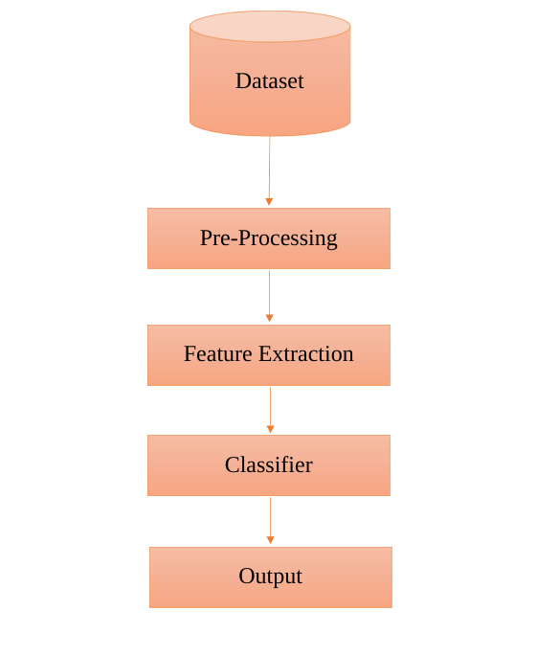
Flow Diagram

Slide 7
Working Modules
Dataset upload
• Pre-processing data
• Extracting dataset
• Splitting dataset training and testing
• Applying models.

Slide 8
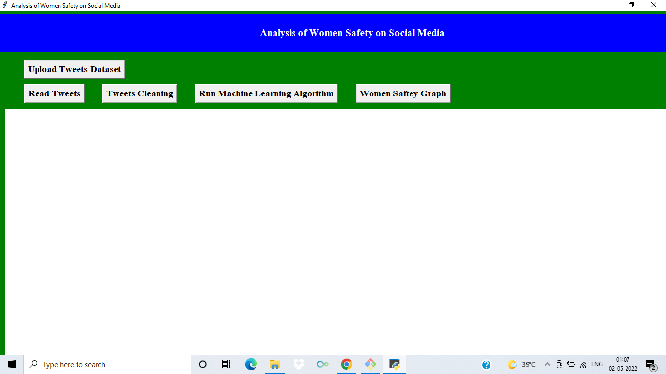
Output Window

Slide 9
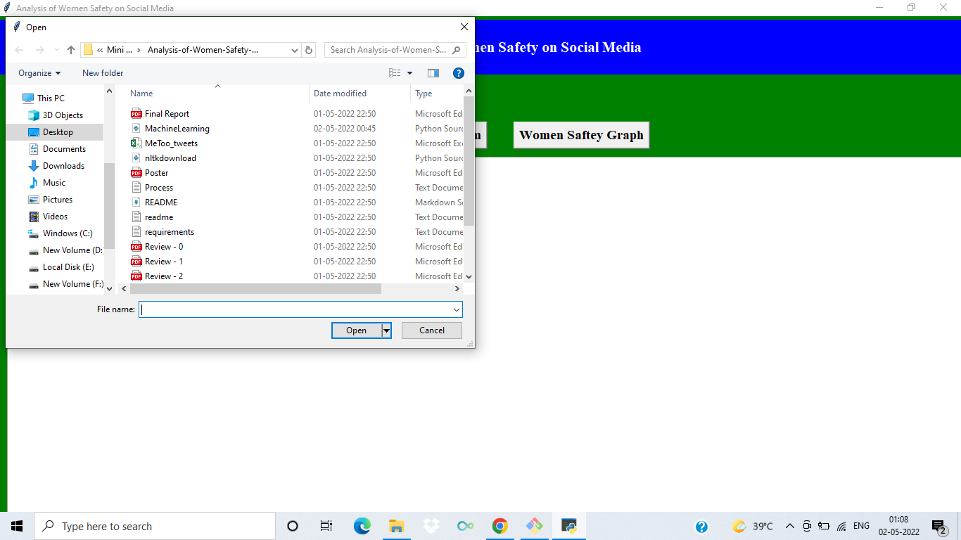
Uploading Dataset

Slide 10

Dataset Uploaded

Slide 11
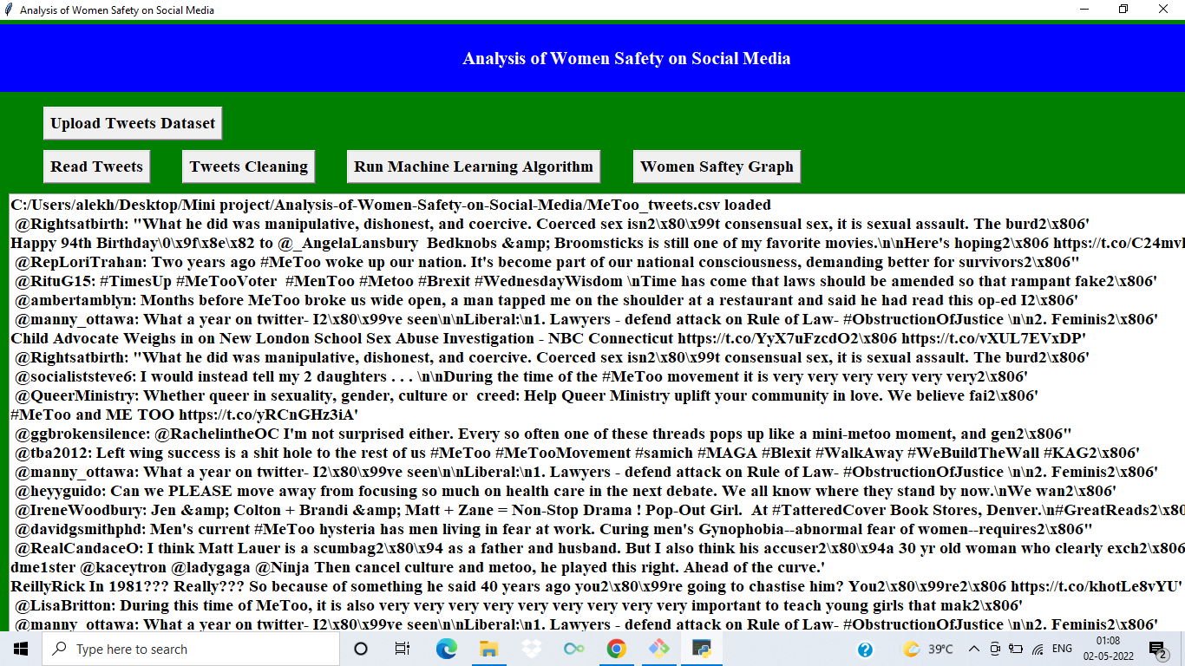
Reading Tweets

Slide 12
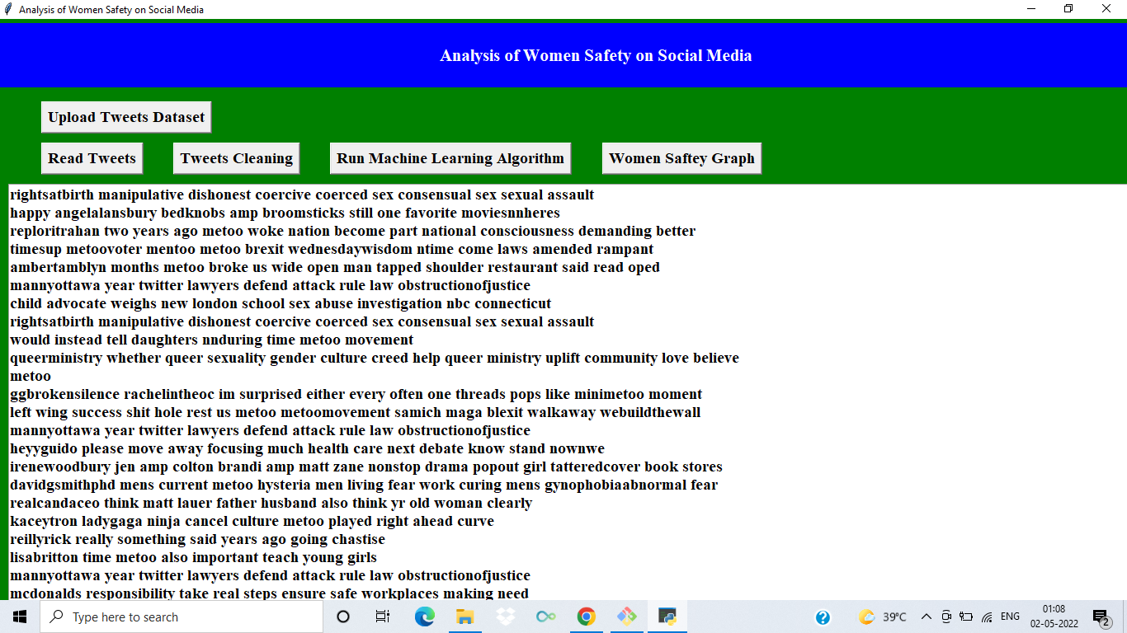
Cleaning Tweets

Slide 13
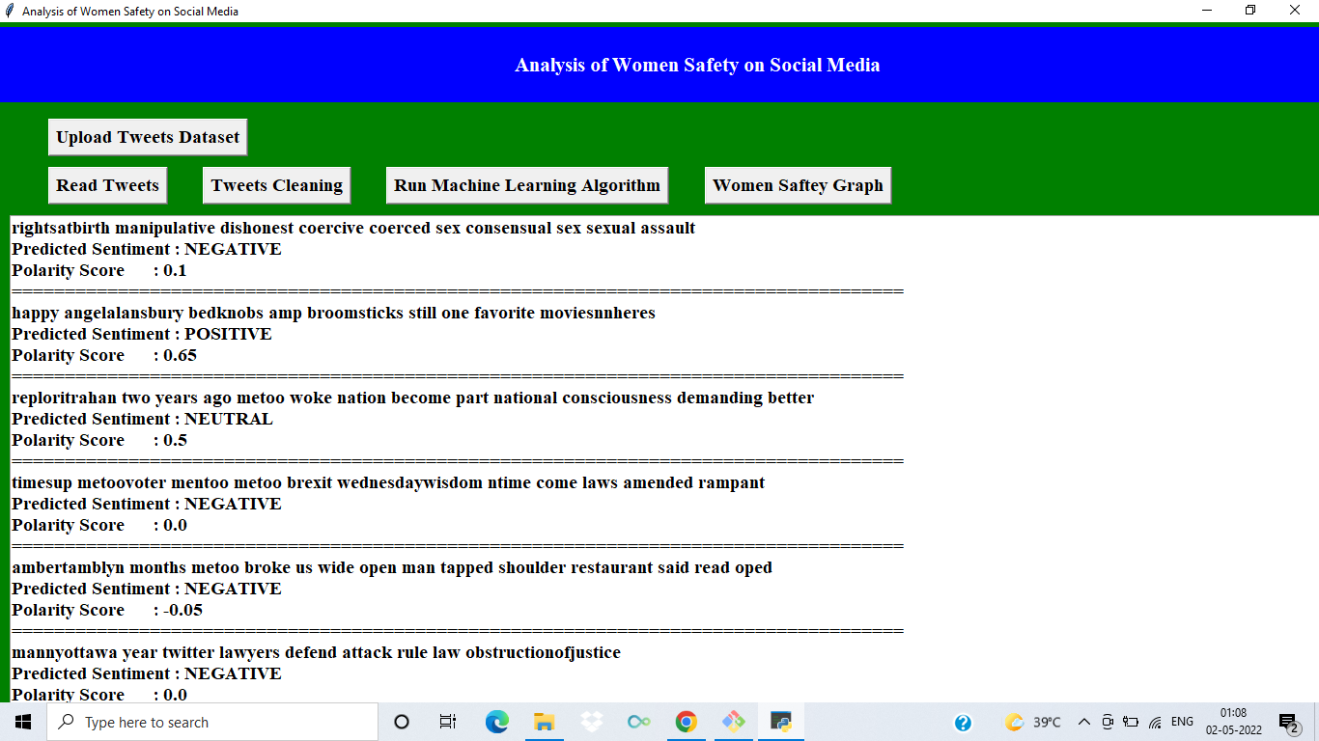
Running ML Algorithm

Slide 14
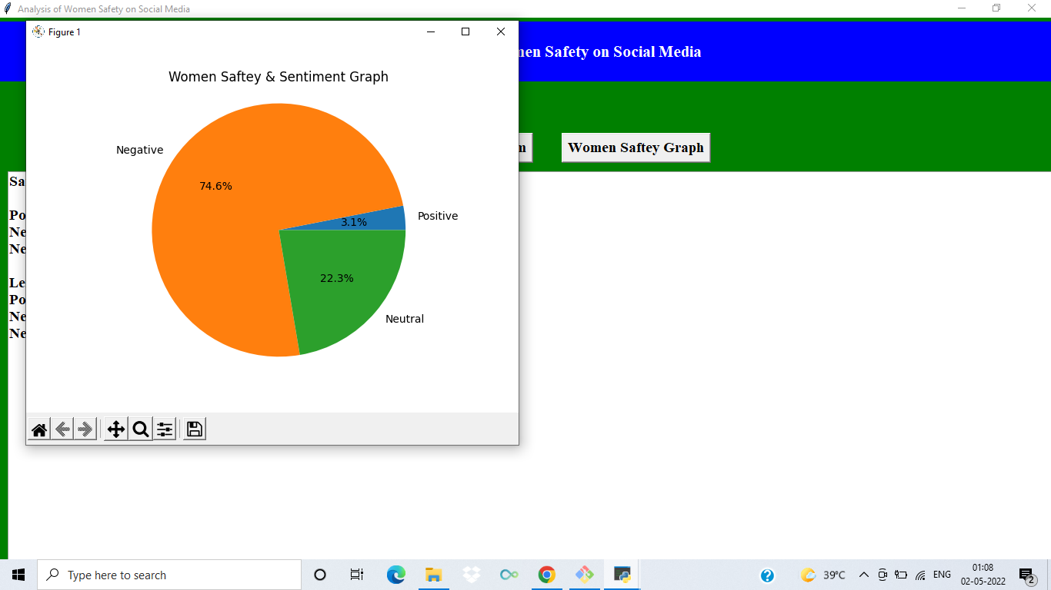
Implementing Pie chart

Slide 15
SYSTEM SPECIFICATIONS
ENVIRONMENT | SPECIFICATIONS
HARDWARE | Intel core i5 Processor RAM 4GB Hard Disk Drive 1TB
SOFTWARE | Windows 10 Python idle 3.10 GIT Bash 2.36 Visual Studio Code 1.66

Slide 16
CONCLUSION
In this we have used different Machine Learning techniques that can push us to put together and examine the immense measure of Twitter information. Subsequently we can perform AI calculations to accomplish nostalgic investigation and carry more safety and security to ladies by spreading the mindfulness. For the future improvement, we can stretch out to apply these Machine Learning techniques on various web-based media stages like face book and integral likewise since in our work just twitter is thought of. Present viewpoint which is proposed can be incorporated with the twitter application interface to arrive at bigger degree and apply wistful examination on a large number of tweets to give more wellbeing.

Slide 17
REFERENCES
[1] Deepak Kumar , Shivani Aggarwal ,Analysis of Women Safety in Indian Cities Using Machine Learning on Tweets, 2019 (Base Paper). [2] Gupta, B., Negi, M., Vishwakarma, K., Rawat, G., & Badhani, P. Study of Twitter sentiment analysis using machine learning algorithms on Python (2017). [3] Sahayak, V., Shete, V., & Pathan, A, Sentiment analysis on twitter data. (2015) [4] Mamgain, N., Mehta, E., Mittal, A., & Bhatt, G, Sentiment analysis of top colleges in India using Twitter data (2016, March). [5] Barbosa, Luciano, and Junlan Feng. "Robust sentiment detection on twitter from biased and noisy data." 2010. [6] Bermingham, Adam, and Alan F. Smeaton. "Classifying sentiment in microblogs: is brevity an advantage." ACM, 2010.

Slide 18
THANKYOU

